Slide 1


Responsible Machine Learning
Capstone Project
Surafel Debebe, Xiaowei Cen, Percy Rodriguez,
Lin Shu Tseng, Ramin Gamzaev

Slide 2


What we do
End-to-end audit of a loan approval model using HMDA data
Focus on performance, fairness, and deployment risk
Data & Setup
2024 HMDA Loan Application data (154K samples)
Binary label: approved (1) vs denied (0)
Models
Logistic Regression (interpretable baseline)
Gradient Boosting (high-performance model)
Goal
determine whether the model is accurate, fair, and defensible for deployment

Slide 3

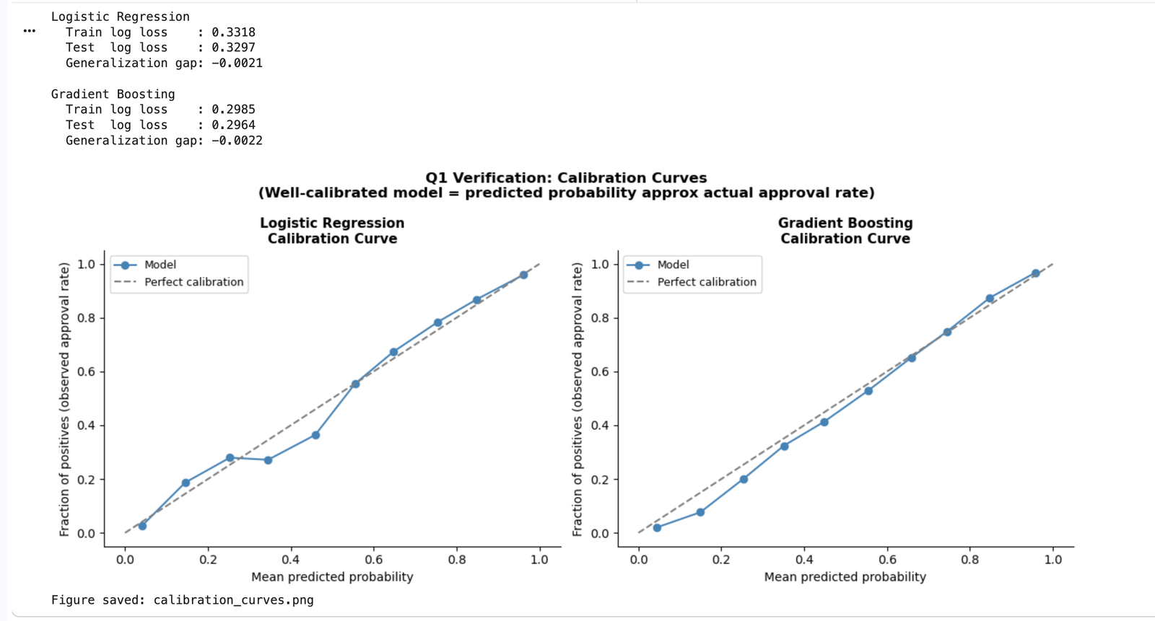
Ｑ1:Optimization Objective
Training objective: minimize log loss
Model selection: maximize AUC
Output: probability score
Loss function: Binary cross-entropy
Why cross-entropy:
• Well-calibrated probabilities
• Penalizes confident errors
• Suitable for decision-making
Limitations:
• Group-blind
• Class imbalance sensitivity
78.4% approval rate
• Arbitrary threshold
• Fairness trade-offs
Calibration curves show predicted probabilities align with actual outcomes,
supporting the use of log loss as the training objective.

Slide 4

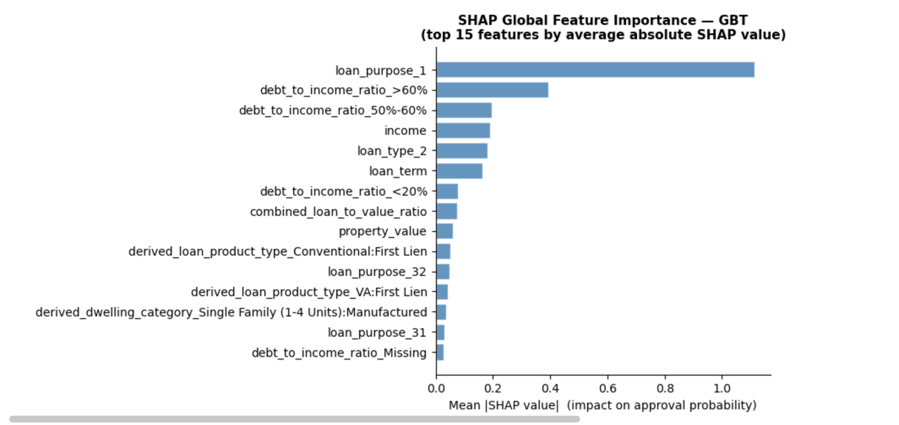
Ｑ2. Known failure modes
We identify multiple ways the model can fail failures arise from:
Feature reliance
- Over-reliance on a small set of features
Model sensitivity
Subgroup disparities
Key observation：Model relies heavily on a small set of features
loan purpose
debt-to-income ratio
income
Risk：These variables may act as proxies for race or income-related groups,
leading to indirect disparities in loan approval outcomes.

Slide 5
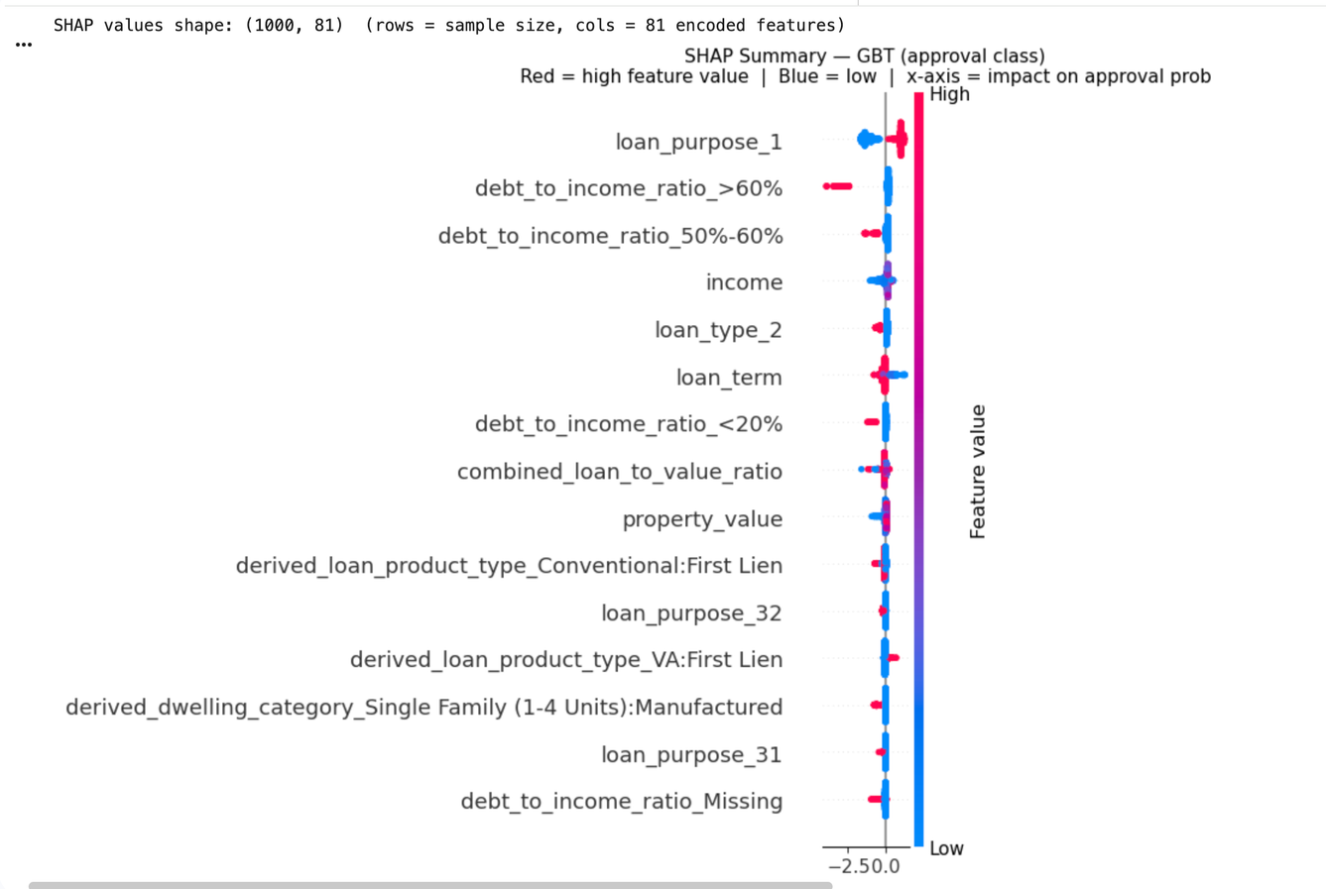
Ｑ2. Known failure modes
We identify multiple ways the model can fail failures arise from:
Feature reliance
Model sensitivity
- Small feature changes can noticeably shift predictions
Subgroup disparities
Key observations:
SHAP analysis shows predictions are highly sensitive to a few dominant features.
• loan purpose
• debt-to-income ratio
• income
Risks
These features may act as proxies for protected attributes
Predictions are sensitive to input changes
→ may lead to unstable or biased decisions

Slide 6
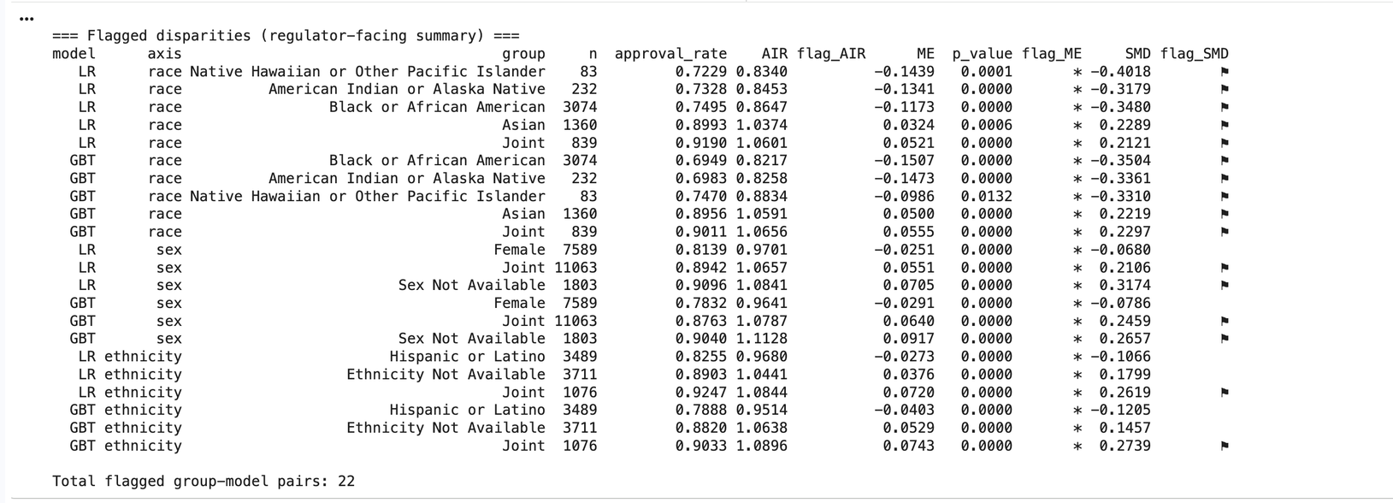
Ｑ2. Known failure modes
We identify multiple ways the model can fail
Failures arise from:
Feature reliance
Model sensitivity
Subgroup disparities
- Unequal approval and error rates across demographic groups
Key observations：
Multiple groups show statistically significant disparities
Total flagged cases: 22
Risks
Unequal error rates across groups
Potential violation of fairness standards

Slide 7
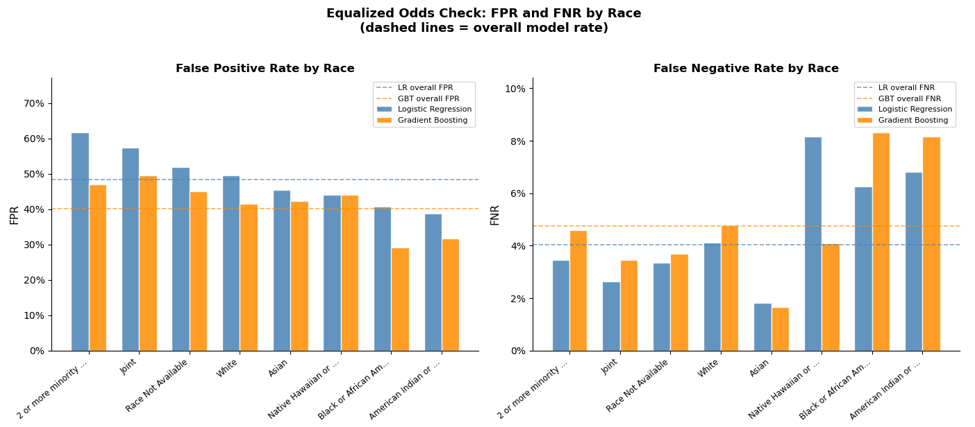

Q3. Subgroup error analysis
We compare subgroup error rates across protected groups.
Metrics shown: False Positive Rate (FPR) and False Negative Rate (FNR) by race.
Dashed lines represent the overall model error rates.
Some groups face materially different error rates than the overall average.
This indicates unequal error burden even when overall performance appears stable

Slide 8
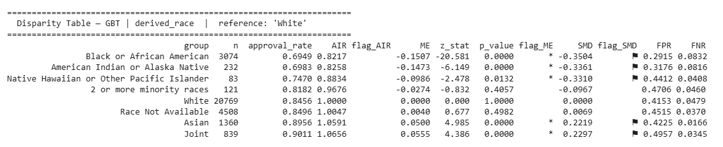
Q3. Subgroup error analysis
We evaluate approval disparities using AIR, ME, and SMD.
Reference group: White applicants.
Under the four-fifths rule, AIR < 0.80 signals potential adverse impact.
In this race-level table, no group falls below AIR = 0.80.
However, several groups are still flagged by ME and SMD, indicating statistically and practically meaningful disparities.

Slide 9


Q4. What risks remain after mitigation?
Mitigation Strategy
Focus on GBT model
Apply post-processing global threshold adjustment
Goal: reduce intersectional subgroup disparity without retraining
Mitigation Results
Global Threshold Mitigation
Selected threshold: 0.46
Single group-neutral decision rule
Designed to improve the lowest intersectional AIR values
Global Threshold
Single threshold: 0.46
Selected to improve the lowest intersectional AIR values
Black Female AIR: 0.7913 → 0.8011
AIAN Male AIR: 0.7944 → 0.8312
Uses one group-neutral decision rule
Residual Risks After Mitigation
FPR differences persist across demographic groups
Model performance may drift after deployment
Sensitive to missing or sparse applicant data

Slide 10

Q5. Is the Model Deployment Defensible?
Model Performance
Fairness Issues
After Mitigation
• GBT achieves strong predictive performance
- High AUC
- Low log loss
• Good generalization on test data
Fairness Concerns
• Significant subgroup disparities
• Some groups fail the 80% rule (AIR < 0.80)
• Unequal error rates (FPR / FNR)
• Threshold adjustment improves fairness partially
• Disparities still remain
• Group-specific policy not legally deployable
Final Conclusion
The model is NOT defensible for deployment
under current fairness and regulatory standards.
 | Candidate | Decision | Op threshold | Test AUC | Min AIR | AUC drop (drift) | AUC drop (NaN) | # hard fails | # soft fails
0 | Logistic Regression (single threshold) | CONDITIONAL | 0.70 | 0.8817 | 0.8102 | 0.0316 | 0.0066 | 0 | 1
1 | Gradient Boosting (Policy A: global threshold) | DO NOT DEPLOY | 0.65 | 0.9063 | 0.7704 | 0.0435 | 0.0218 | 1 | 1
2 | Gradient Boosting (Policy B: group-specific th... | DO NOT DEPLOY | 0.30 (if derived_race) | 0.9063 | 0.7913 | 0.0435 | 0.0218 | 2 | 1

Slide 11


Thank You
https://github.com/XIaoweiCen666/Group-4-responsible-ml-capstone

